Slide 1
Personal pronouncer
To Help Every One With Correct Pronunciation

Slide 2
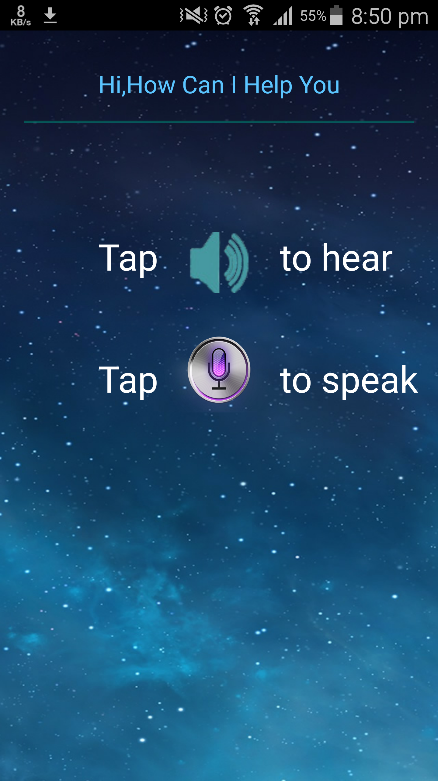
This is the start page of the app
In this page we can give input in two ways by text typing or by voice input with the help of Google speech to text

Slide 3
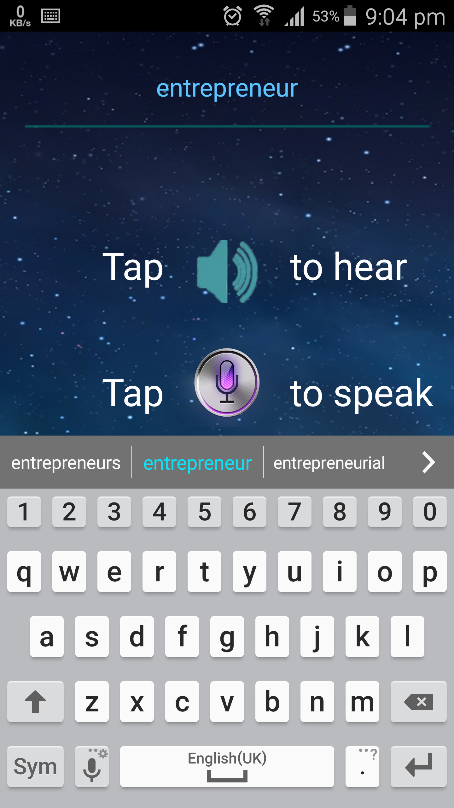
Here you can see how manually we can enter the word by typing

Slide 4
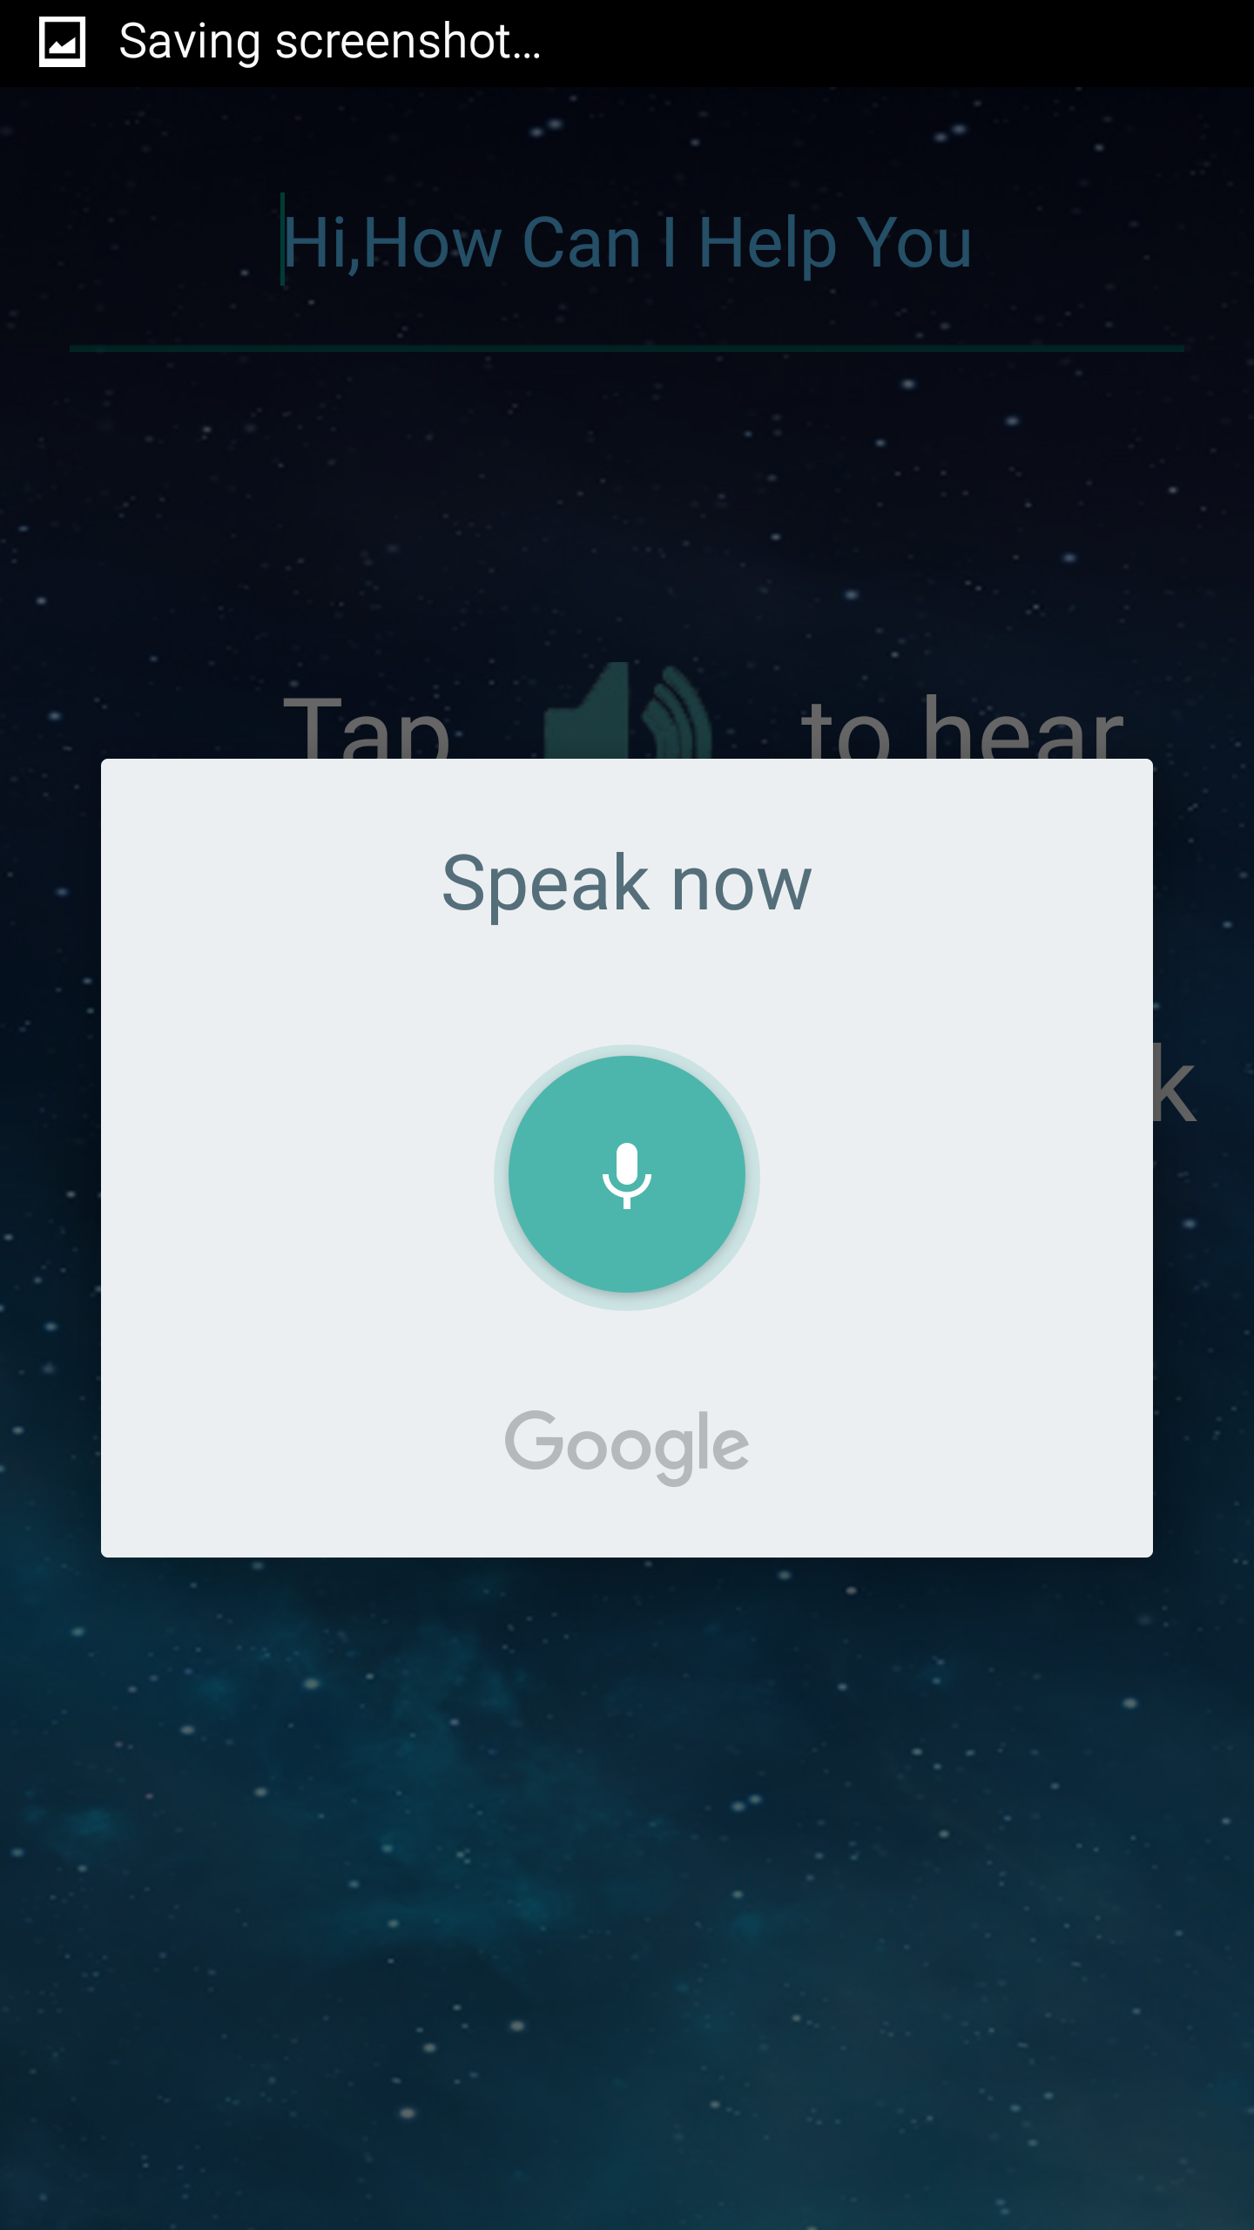

Here it is shown how Google speech to text takes the voice input
For versions above lollipop the offline voice doesn't work
Hover on the mic button then click on the play button and say “Entrepreneur”

Slide 5
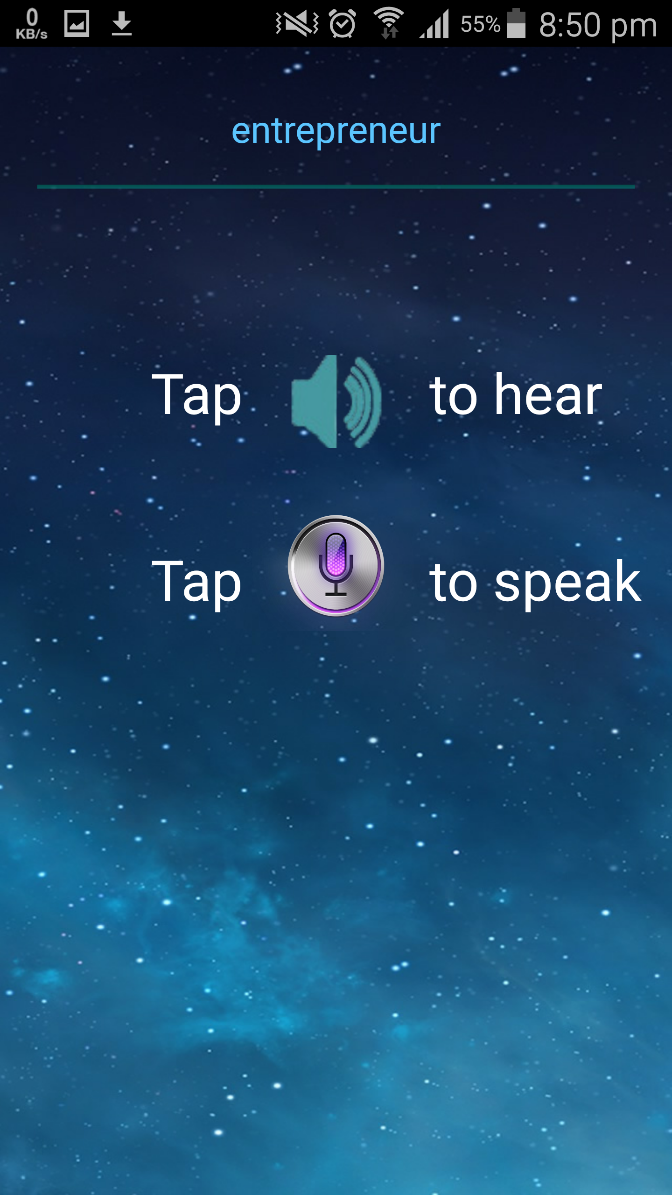

Here you can see the word that is to be pronounced by the phone in this case “Entrepreneur”
Hover on the speaker icon and click on the play button to hear how the app pronounces the word

